Slide 1


SAP S/4HANA CDS, RAP Training Day 9
Anubhav Oberoy

Slide 2

Agenda – Day 9
Sequence Diagram
Implementing Create, Update and Delete
Make field read only
Making field Mandatory
Add validation to the code
Implement Actions - set_status_booked
--break
What is EML ?
Why we use EML
Syntax of EML
C-R-U-D Using EML
Implementation of EML
--break
Introduction to Managed Scenario
Implementing the Processor
Notes:
https://unsplash.com/photos/CPs2X8JYmS8

Slide 3
Fiori App
OData
RAP
B-IMP
Legacy Code
post
Agency customer id
Start date
End date
Create
Create IMPORT
Entities (%cid)
Write to TB
messages
save
Save to DB
cleanup

Slide 4
























Draft

Slide 5







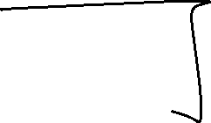






















Slide 6

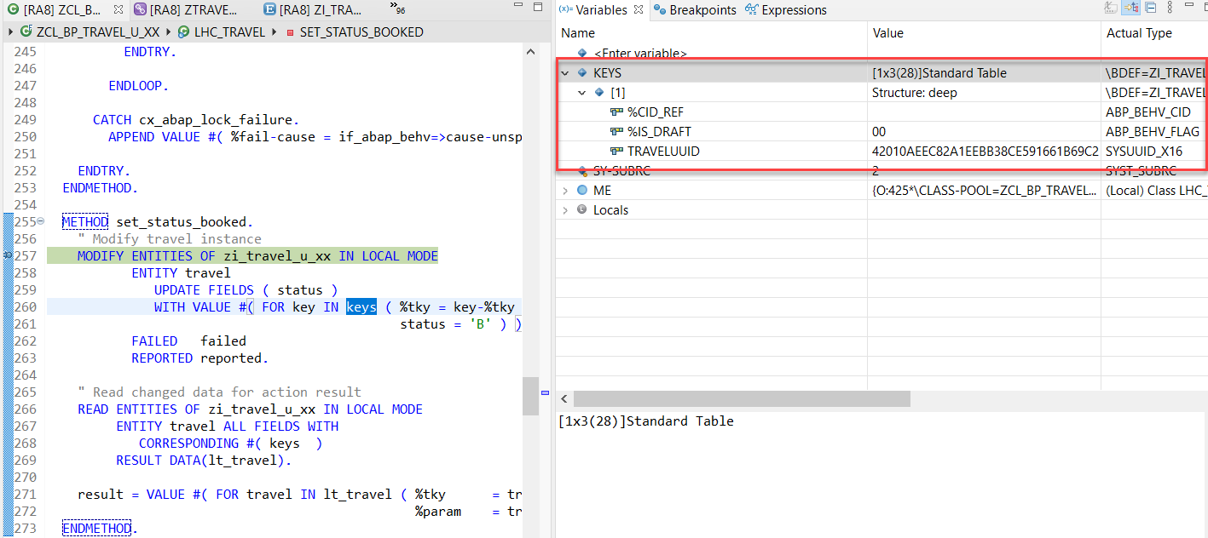
Action Implementation
“Actions” are addition operations in addition to CRUD operations. Are the operations which are non-standard for a business object
Below steps describes the implementation of an action related to the travel instances. Using this action, the end user should be able to change the status of travel processing.
Adding a Type Definition for Import and Export Parameters Required for the Action SET_STATUS_BOOKED
Implementing the Action Handling.

Slide 7
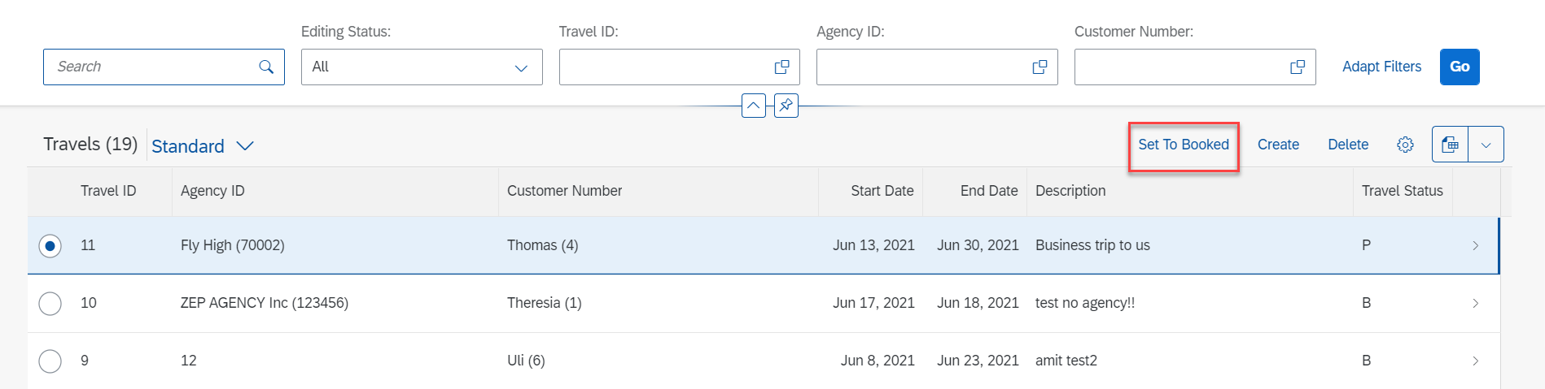
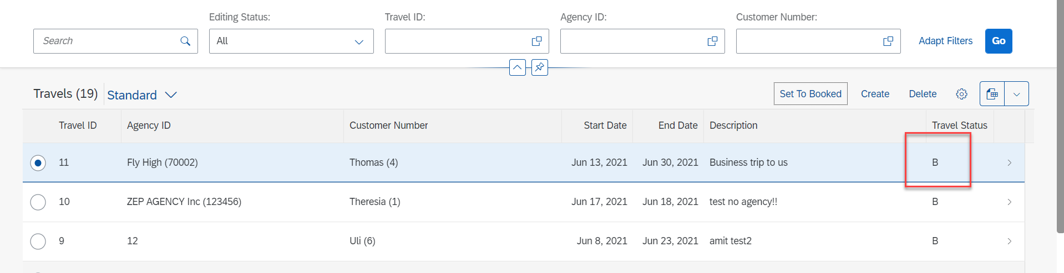
Action Implementation
Select Radio Button and Click on Set To Booked & Travel Status Change to Book (B)

Slide 8
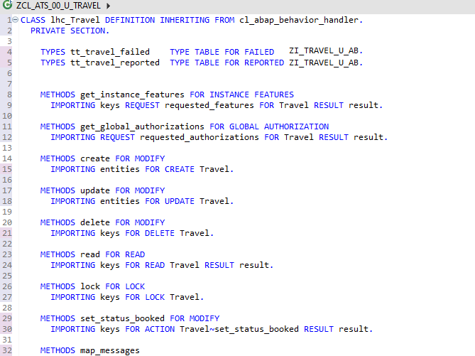
Behavior Pool Logic
Exercise
Behavior Pool Logic

Slide 9
What is EML ?
The Entity Manipulation Language (EML) is a part of the ABAP language that enables access to RAP business objects. Because the consumption of business objects via the OData protocol requires a Fiori UI or a web API, EML enables a type-safe access to business objects directly by using ABAP.
A Business Object in RESTful ABAP is consists of multiple Entities. This is a entity composition tree with one entity acting as a root. EML is part of the ABAP language and used in context of RESTful ABAP to control the BO behavior (create, read, update, delete).
We can use the EML in ABAP to test our BO. We can call the BO using EMP from ABAP program in 2 ways
01
Standard (Statically)
Generically (Dynamic) framework.
02

Slide 10
Syntax of EML
The EML provides us 3 important access statements for Data Manipulation using BO( Business Object ).
01
Perform the CUD ( Create ,Update ,Delete on BO
MODIFY ENTITIES OF RootEntityName
ENTITY EntityAliasName
[ CREATE FROM it_instance_c ]
[ UPDATE FROM it_instance_u ]
[ DELETE FROM it_instance_d ]
[ CREATE BY \AssociationName FROM it_instance_cba ]
[ RESULT et_result_tab ] [ FAILED failed ] [ REPORTED response ] [ MAPPED mapped ]
02
Commit Entities
Will actually persist the changes in the DB from transaction buffer. Any modify operation that are executed within behavior pool or by ABAP program are not causing any DB change because they are applied on transaction Buffer and this buffer content will disappear when ABAP session ends. So if we want the changes to be passed to SAVE SEQUENCE and persisted, we will use the COMMIT ENTITIES statement.
finalize ( )
check_before_save( )
Adjust_numbers( )
Save( )

Slide 11
Syntax of EML
03
Read the Data
All operations that do not need to change the data of an entity are carried out by READ Data.
There 2 types of Read
Read Entity by Key
Read Access to child (association) by parent key
Read Statement always returns the RESULT and you must specify target variable. We can also read the associated entity data using BY \asso_name FROM it_table syntax.
The result of associated data with come in another internal table LINK tab_name, it will always contain the key value pair.
READ ENTITIES OF RootEntityName
ENTITY EntityAlias FROM it_read_condition
RESULT et_result
BY \asso_name FROM it_read_rba
RESULT et_res_rba
LINK et_link_keys
ENTITY EntityAlias FROM it_ins_2…. [ FAILED failed ] [REPORTED reported]

Slide 12

Rule for EML
In addition to the data we also have a compiler generated field in input and output results called %control, this field is responsible to inform the RESTful framework that, which are all the fields we would like to send to DB while creation or update while updating. Also while read we can specify the same to avoid reading everything.
We can also see the complete BO structure in BO Explorer using keyboard shortcut :-
Alt+Shift+W

Slide 13
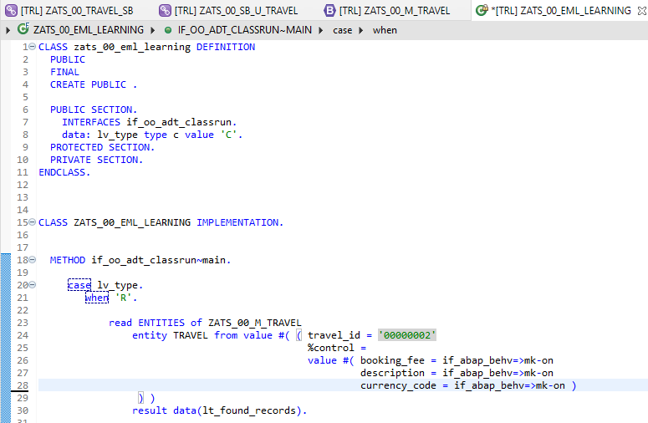
Implementing EML

Slide 14
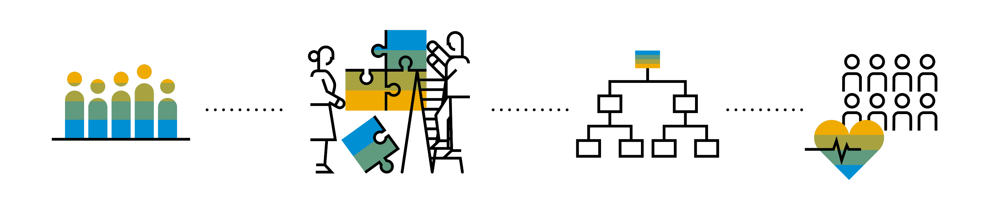
Introduction to Managed Scenario
Let us consider we have been given a green field and asked us to develop a villa from scratch with our own customization. So, what steps will be involved in it? We need to design the floor-plan of the villa, the sections we want to include in the house like pool area, a garden, a jogging track etc. And we will proceed with selecting materials, selecting vendors, enforcing conciliation and orders and many more steps. Similarly, the RAP’s managed scenario provides the greenfield development for our business object.
In the managed scenario, the implementations of behavioral elements like Create/Update/Delete are managed by the RAP framework itself. However, to implement complex logic like validations, determination or some sort of actions (Submit, Approval, Reject etc.) on the business entity, you need to add the ABAP logic for it in implementing classes.

Slide 15



Use Case for Managed Scenario
I am working as a ABAP on Cloud developer for one of the travel planner agency, which has just taken the BTP subscription. They want me to create 2 fiori apps for the travel industry
Processor Application
Approver Application
MakeMyTrip.com
Source → Destination
Start → End Date
How many
Travel Itinerary
Travel Request which has multiple Bookings
Create a travel request and add bookings with all the properties changeable
Updates booking fees and description and provide approvals
Processor
Approver

Slide 16

Steps for Build Use Case
Fiori App for Processor
Fiori App for Approver
Service Def and Binding
Service Def and Binding
CDS Data Model
CDS Projection for Processor @UI
CDS Data Model
CDS Data Model
CDS Projection for Approve @UI
Introduction
1..1
Behavior Def
Projection (processor)
Behavior definition
Behavior definition
Behavior Def
Projection (approver)
Behavior definition
Behavior Implement (pool)

Slide 17
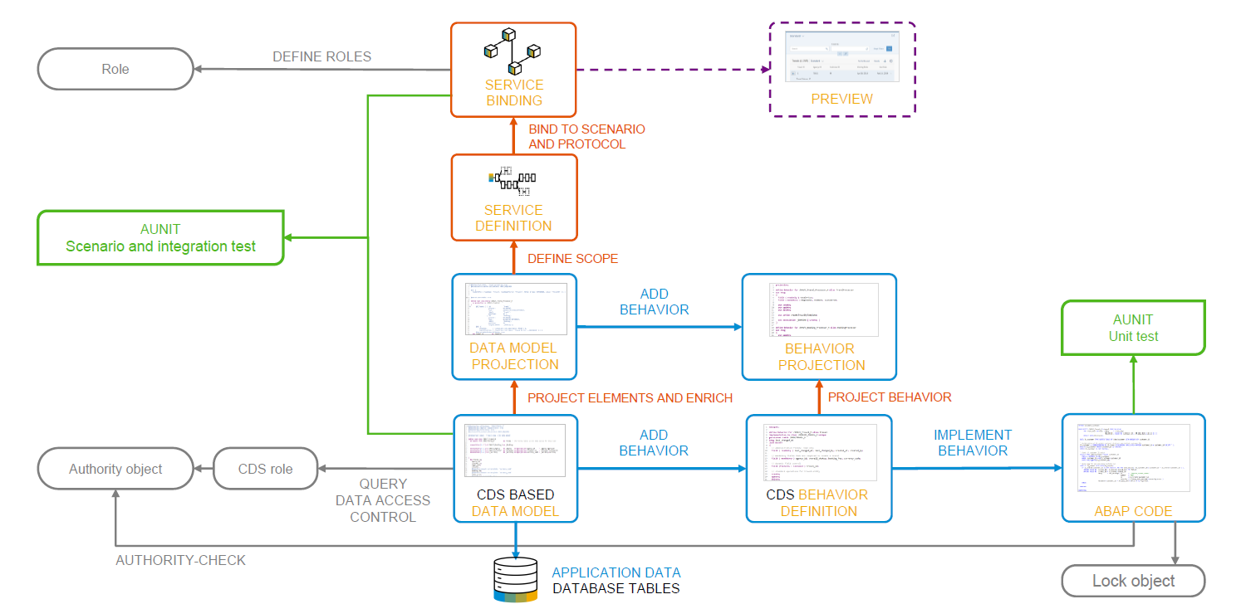
Development flow

Slide 18
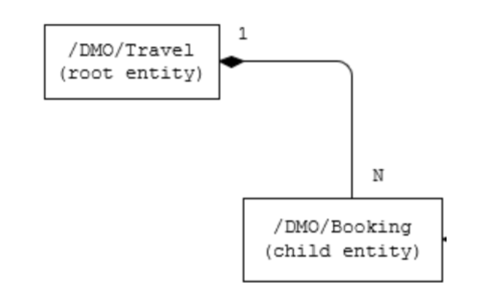
Our new Business Object
From a structural point of view, a business object consists of a tree of entities that are linked by compositions. Every entity in this composition tree is an element that is modeled with a CDS entity. For our demo travel booking scenario, we will implement a 2-level hierarchy composition tree.
As depicted in the figure below, the 2-tier entity hierarchy for managing transactional data in our scenario consists of the following editable entities, with a 1: N cardinality on each level:
Travel
Booking
i.e. each travel instance has 0..N bookings The figure below shows the composition relationship between the travel and the (flight) booking entities, where the travel entity represents the root of the data model.

Slide 19
Title
Text

Slide 20
Title
Text

Slide 21

Questions?

Slide 22

Thank you
Anubhav.abap@gmail.com
contact@anubhavtrainings.com
+91 84484 54549
www.anubhavtrainings.com

